Slide 1

Training Course (3 weeks)
What I need to know right now
Notes:
Script:
”Have you ever had an idea (pop up light bulb) that could help your organization but didn’t have a way of sharing it with those that could implement the changes?”
“Have you wanted to learn about something specific to your job or position but didn’t want to sit through a three week course just to learn about it?”
“What if, in the future, you could avoid coving the same topics while setting your own goals of the things you wanted to learn and how you wanted to learn them?”
“Intro the Cyber Education Hub. This collaborative tool offers the capabilities for all DoD members to share novel and potentially game-changing ideas with a community focused on cyberspace education. This solution, while still under development, is contributing to the Air Force’s next generation of comprehensive education and training tools.

Slide 2
Self-Directed Learning in Cyber Education and Training
The views expressed are those of the author and do not necessarily reflect the official policy or position of the Air Force, the Department of Defense, or the U.S. Government.
Capt Nathan Flack
1 Nov 2018
Notes:
Intro: “My name is Nathan Flack, I am a Captain in the U.S. Air Force and this video has been created to partially fulfil the requirements of CSCE 525 – Introduction to Cyber Warfare & Security a course offered at the Air Force Institute of Technology.”
This video discusses the theory behind self-directed learning and how it contributes to building lifelong learners. It will then provide a quick overview of the Cyber Education Hub and show how it encourages self-directed learning in the realm of cyberspace.
Disclaimer: “The views expressed are those of the author and do not necessarily reflect the official policy or position of the Air Force, the Department of Defense, or the U.S. Government.”

Slide 3

“…be prepared to deal with technological, operational, and tactical surprise, which requires changes to the way we train and educate our leaders and our forces…”
Notes:
The Secretary of Defense, James Mattis, emphasized the need for changes to our education and training sytems.
that the US Armed Forces need to “be prepared to deal with technological, operational, and tactical surprise, which requires changes to the way we train and educate our leaders and our forces…”
﻿James Mattis, “Secretary of Defense Jim Mattis House Armed Services Committee Writ-
ten Statement for the Record,” 12 Jun 2017, http://www.politico.com/f/?id=0000015c-9f04-d0 70-a57d-fffe4c600001. 7.

Slide 4
AETC’s goal in shifting to a Continuum of Learning (CoL) is to build lifelong learners
Blended Learning
Notes:
Air Education and Training Command, or AETC, is answering this call and other requirements….
By building a framework with associated tools to transform the way the Air Force conceptualizes, conducts, and tracks education and training.”
The overall goal is to use 21 century methods and tools to better educate and train the Air Force in order to produce lifelong learners.
It’s framework is centered around 5 key ideas:
Blended Learning: “Blended Learning is education and training delivered through a combination of learning modes. Self-paced, facilitated, simulations, games, and collaborative learning to name a few.”

Slide 5
AETC’s goal in shifting to a Continuum of Learning (CoL) is to build lifelong learners
Blended Learning
Modular Learning
Notes:
Modular Learning: “Instead of a longer course focused on a variety of topics, airmen are offered learning in small packets and can choose individual modules based on their needs.”

Slide 6
AETC’s goal in shifting to a Continuum of Learning (CoL) is to build lifelong learners
Blended Learning
Modular Learning
Airman’s Learning Record (ALR)
Notes:
Airman's Learning Record: “the ALR is a comprehensive and complete record of all learning (education, training, and experience) Airmen achieve during the course of their career.

Slide 7
AETC’s goal in shifting to a Continuum of Learning (CoL) is to build lifelong learners
Blended Learning
Modular Learning
Airman’s Learning Record (ALR)
Competency-Based Learning
Notes:
Competency Based Learning: “Competency-Based Learning is an outcomes-based approach that gives credit to Airmen in the form of a certification or badge for the skills and knowledge they have demonstrated through performance.”

Slide 8
AETC’s goal in shifting to a Continuum of Learning (CoL) is to build lifelong learners
Blended Learning
Modular Learning
Airman’s Learning Record (ALR)
Competency-Based Learning
On-Command & On-Demand Learning
Notes:
On-Command & On-Demand:
“On-Command is Air-Force-required learning to achieve a level of expertise. This describes training that the Air Force will require for a specific position or career field.”
“On-Demand is self-initiated learning Airmen seek out to achieve personal and professional goals.”

Slide 9
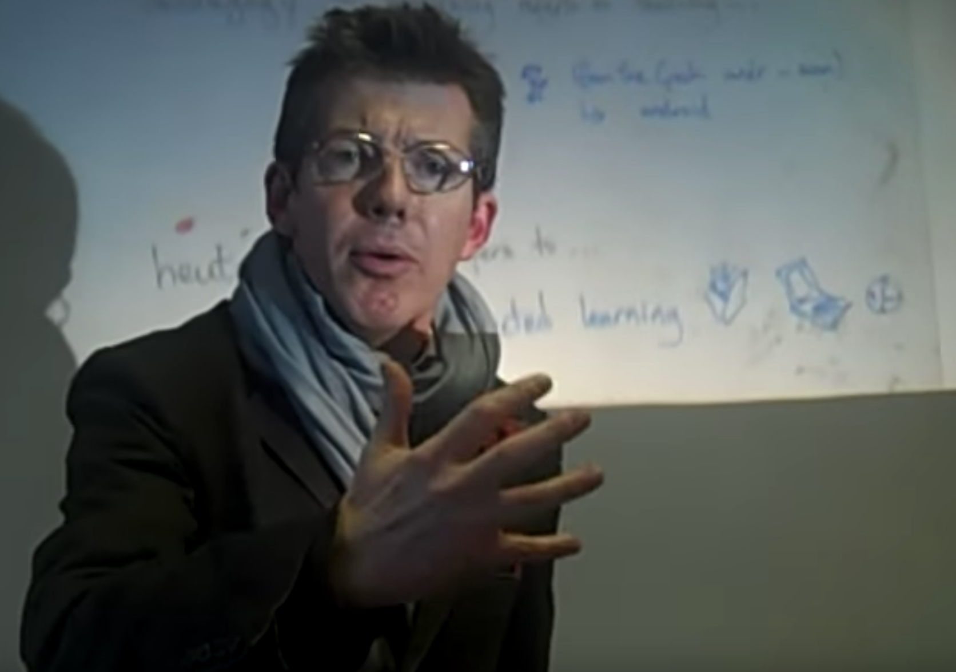
Teaching & Learning “Gogys”
Pedagogy
Andragogy
Heutagogy
Professor Alabaster McAlastair
Just as good as “BOOM goes the dynamite!”
Notes:
Pedagogy -
Andragogy -
Heutagogy -
You can thank me now that I explained these terms and saved you from THIS.

Slide 10
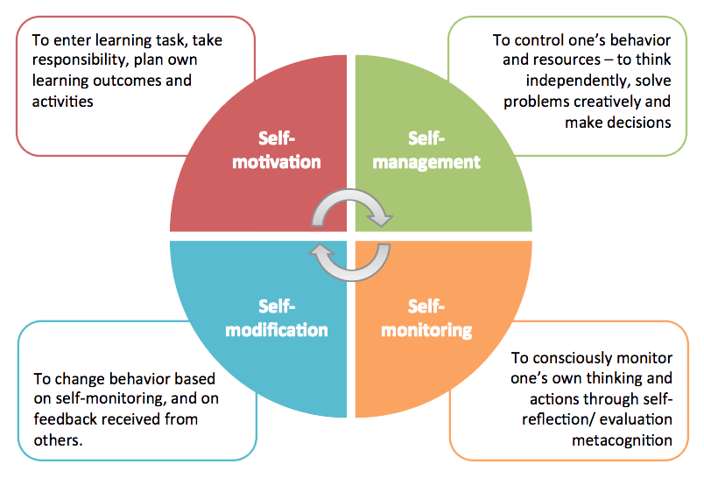
What is Self-Directed Learning?
Picture from Singapore Management University <https://cte.smu.edu.sg>

Slide 11
Technology Tools for SDL
Easy to use
Open
Dynamic
Provide Collaborative Options
Enduring

Slide 12


“The Cyber Education Hub delivers powerful cyber education and training content by empowering the brightest academic minds, the most experienced operators, and the most visionary strategists to share their knowledge and expertise.”
Notes:
Will use “video logo” if available

Slide 13
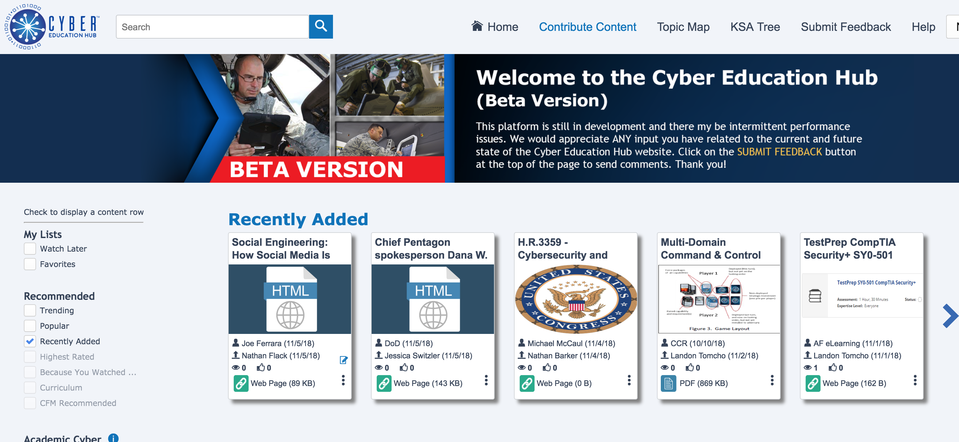

Slide 14
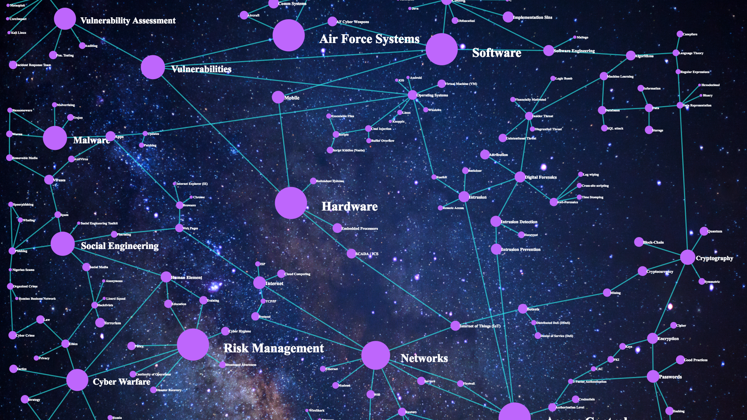
Topic Map

Slide 15
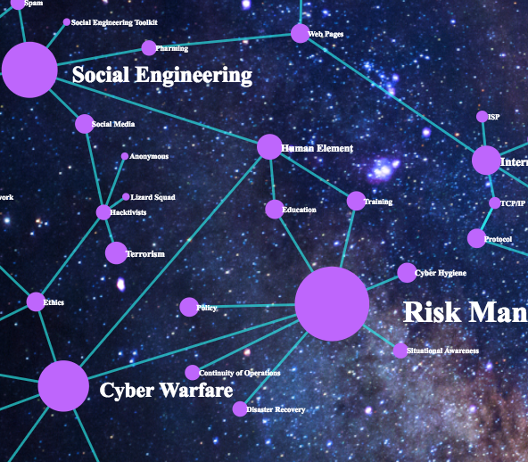
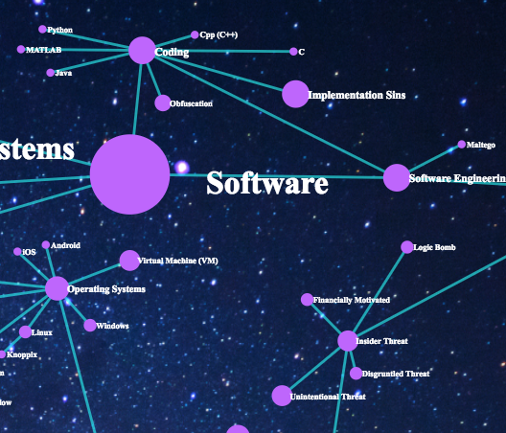

Slide 16
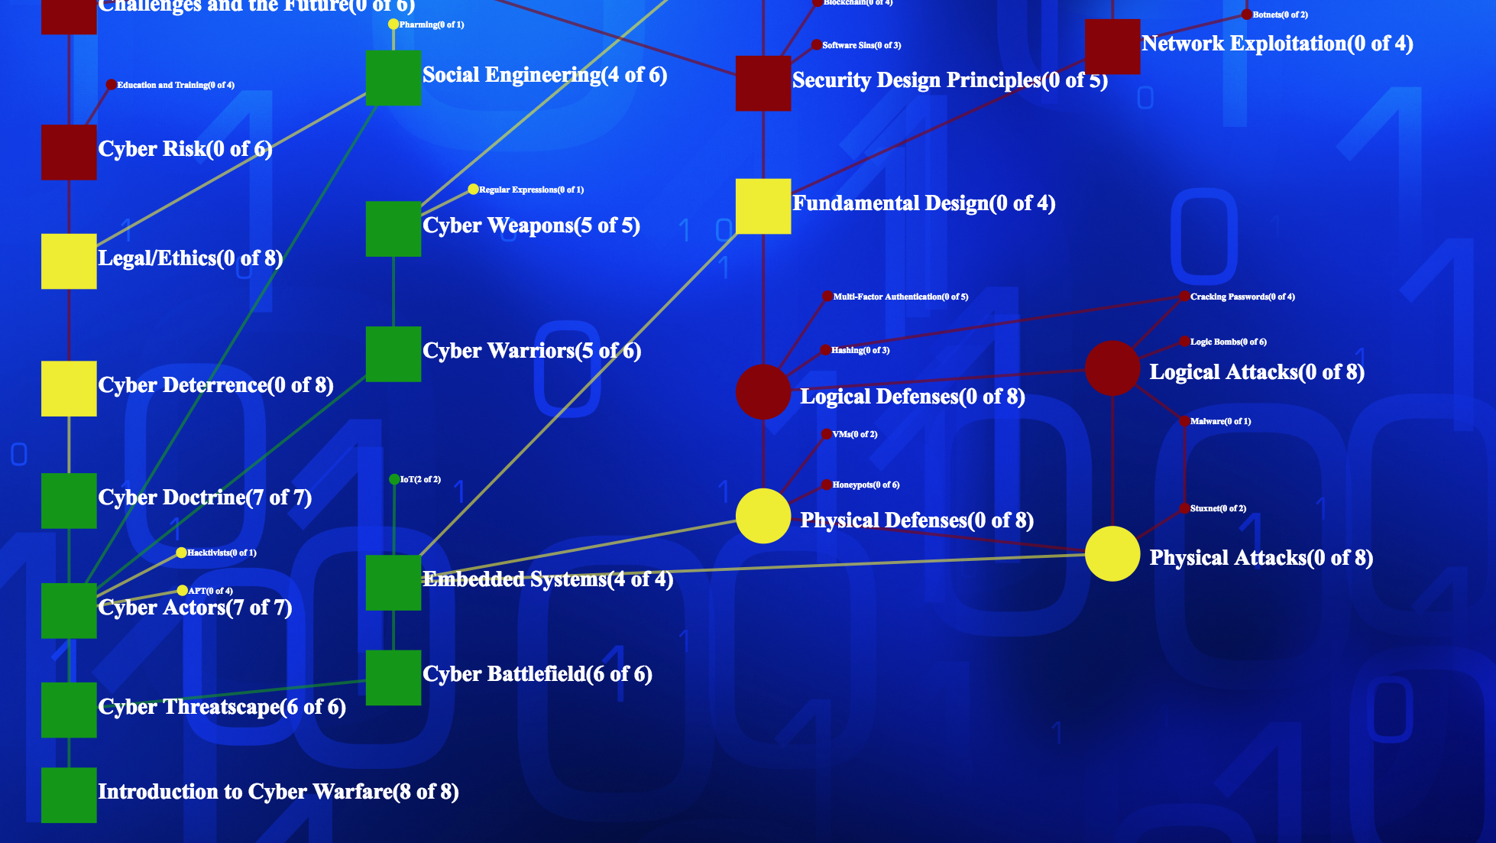
KSA Tree

Slide 17
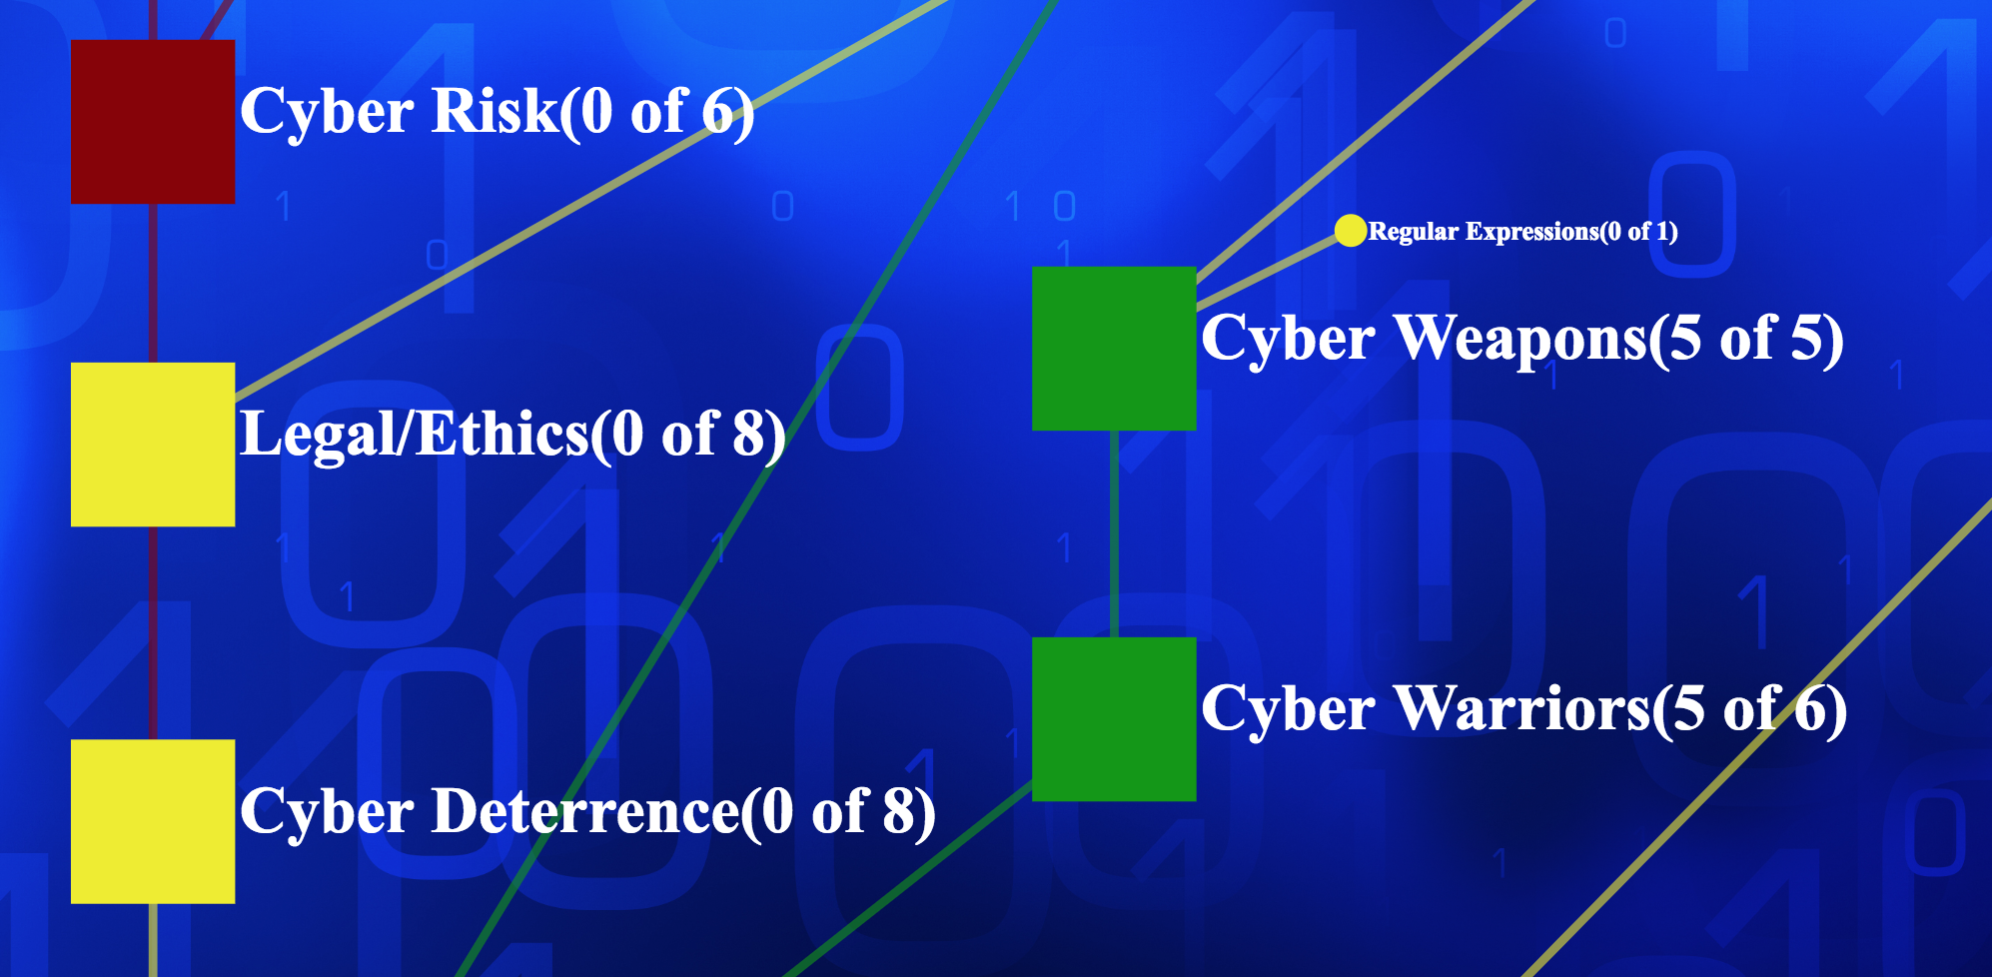

Slide 18
Notes:
Highlight the “Contribute Content” section for those that have access to the Cyber Education Hub to start

Slide 19
Conclusion
Notes:
Summarize the critical role education plays in preparing cyber warriors and how SDL tools can help to fuel these cyber warriors and create lifelong learners across the Air Force. These lifelong learners will be able to adapt to new situations by continuously expanding their knowledge, skills, and abilities and connecting it back to the ”map” of their current understanding.

